Slide 1

Product Demand Prediction With Machine Learnings
PRESENTED BY:
JASPER. E
JAITHITHRA. R
KEERTHANA. S
LIKITHA. R
MATHIMITHRA K.V.V
MERLIN VENSIYA. V

Slide 2

PROBLEM STATEMENT
To create a machine learning model that forecasts product demand based on historical sales data and external factors

Slide 3


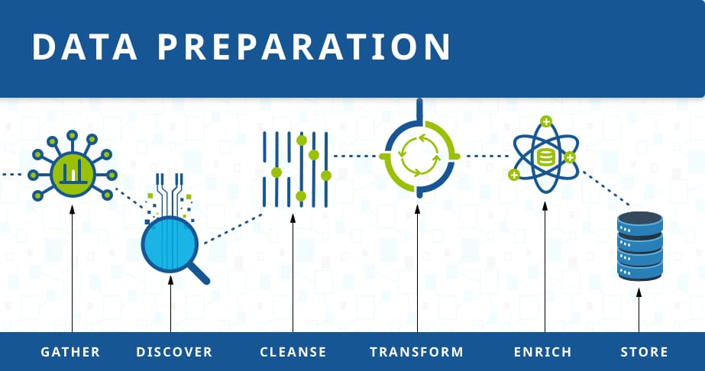
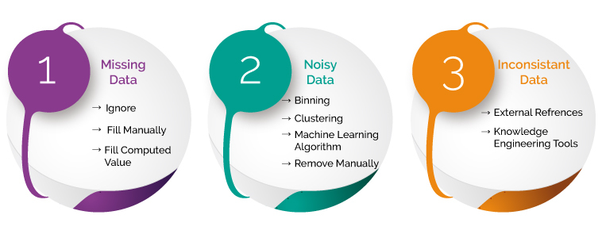
OBJECTIVE
The goal is to help businesses optimize inventory management and production planning to efficiently meet customer needs. This project involves data collection, data preprocessing, feature engineering, model selection, training and measuring of accuracy for predicting the demand of the product.
This Photo by Unknown Author is licensed under CC BY-SA

Slide 4
DATASET COLLECTION
MODEL CREATION
ID
STORE ID
TOTAL PRICE
BASE PRICE
UNITS SOLD
Model Selection
- Decision Trees
- Random Forests
- Gradient Boosting
Model Training
FEATURE ENGINEERING
TRAIN AND TEST DATASET
Monitoring and
Maintenance
Documentation and Reporting
Legal and Ethical Considerations
Data Splitting
Randomization
Split Ratio
METHODOLOGY

Slide 5

PREDICTION ANALYSIS
In demand forecasting, machine learning algorithms can analyze historical sales patterns and predict future trends.
The first step is collecting data about past sales, such as product type, quantity sold, purchase frequency, seasonality, discounts, and more.
This data is fed into the algorithm to create models that identify sales patterns over time. Once these patterns are identified, they can be used to create an accurate forecast for future trends.

Slide 6
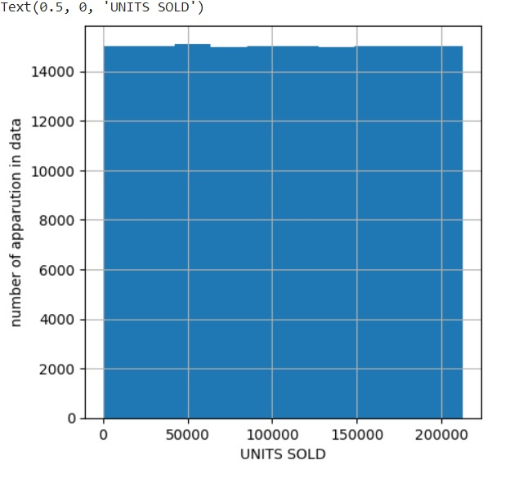
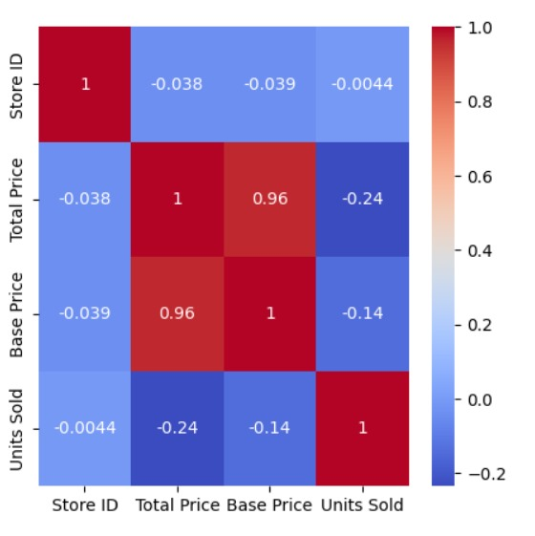
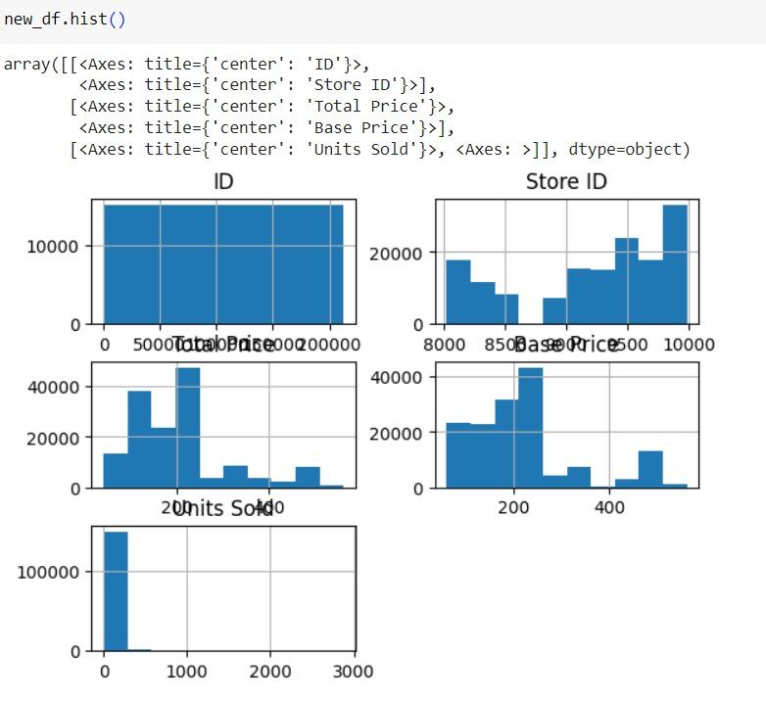
RESULT ANALYSIS MATRIX

